Slide 1



MEETING IS
STARTING
SOON
FOLLOW US!
@tidaltamu

Slide 2
t i d a l t a m u
TETHERED INFORMATICS & DATA ANALYTICS LAB
Notes:
Follow us on Twitter and Instagram @tidaltamu
Join our discord and slack, links provided in email

Slide 3
Introduction to Supervised Learning, Classification, Linear Regression, Logistic Regression
Carson Duffy and Saini Ye
Notes:
How many of you have used linear/logistic regression before?

Slide 4
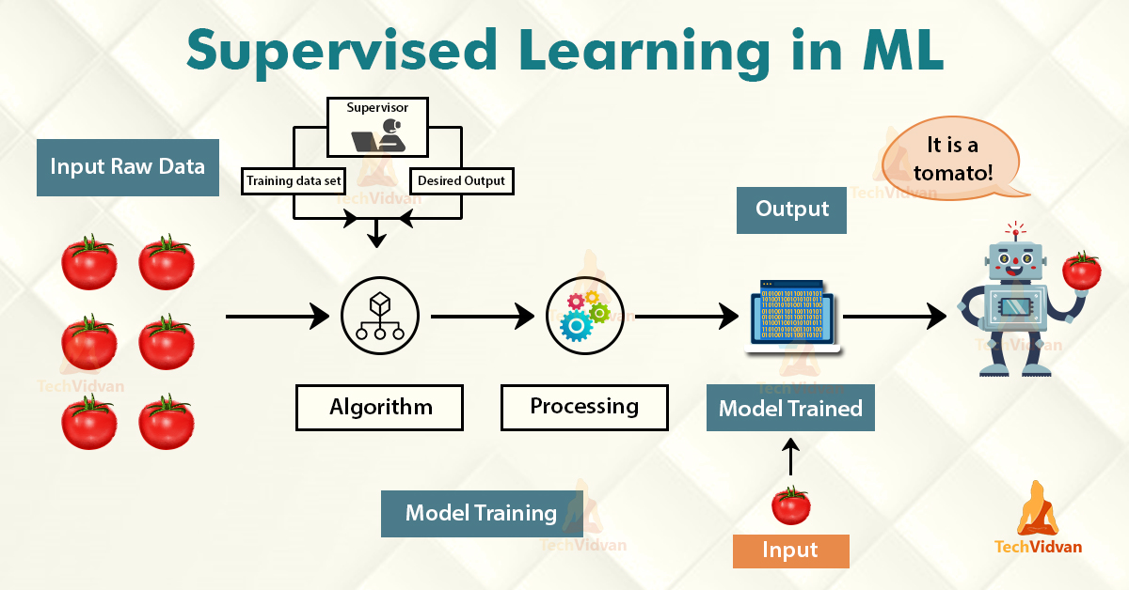
Supervised Learning
Notes:
A class of systems and algorithms that determine a predictive model using data points with known outcomes
A teacher-student relationship
Create machine learning models for two types of problems:
Regression
Classification
The model is learning by training through an appropriate learning algorithms ( such as linear regression, random forests, or neural networks) that typically works through some optimization routine to minimize a loss or error function.

Slide 5
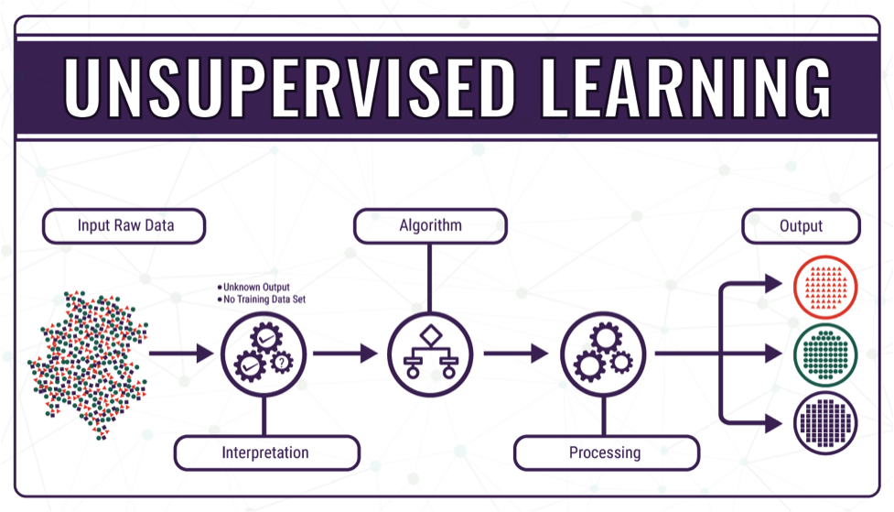
Unsupervised Learning
Notes:
Unsupervised Learning is a machine learning technique in which the users do not need to supervise the model. Instead, it allows the model to work on its own to discover patterns and information that was previously undetected. It mainly deals with the unlabelled data.
Unsupervised Learning Algorithms allow users to perform more complex processing tasks compared to supervised learning. Although, unsupervised learning can be more unpredictable compared with other natural learning methods. No labels are supplied during training for unsupervised learning, hence different learning algorithms are required such as clustering, anomaly detection, neural networks, etc.

Slide 6
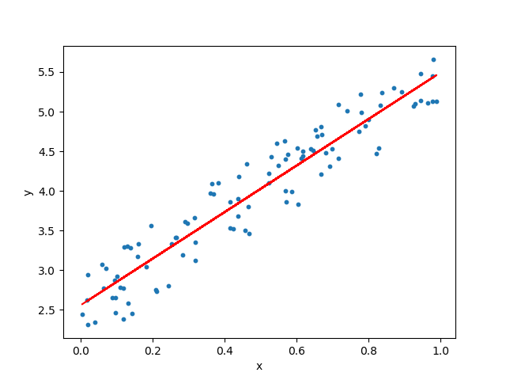
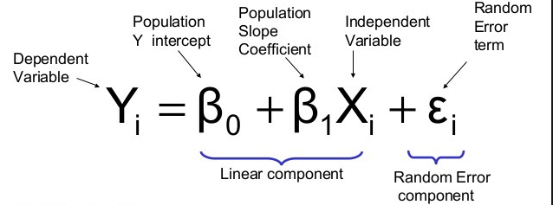
Linear Regression with One Variable
The correlation between the independent variable x and dependent variable y
Minimal error → make prediction more accurate
Notes:
One of the most well understood algorithms in statistics and Machine Learning
Starting one variable is a fundamental step if we want to understand thoroughly how the linear regression works
The goal is to find the fit of the line. The best fit means where the error is minimum. It can make our prediction more accurate.

Slide 7
Linear Regression with Multiple Variables
Uses several explanatory variable to predict the outcome of a response variable
→ estimates the relationship between a quantitative dependent variable and two or more independent variables using a straight line
Notes:
Also known simply as multiple regression, is a statistical technique that uses several explanatory variables to predict the outcome of a response variable.

Slide 8
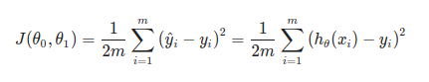
Cost Function
Cost Function helps us to figure out which hypothesis best fits out data → measure the accuracy of the hypothesis
Use equation to determine how wrong the model is in terms of its ability to estimate the relationship between X and Y.
Helps learners to correct/change behavior to minimize mistakes
Notes:
Which basically means how much far away your predicted line is from the actual points that we were already given.
J(theta) is the cost function equation. The h(theta)(xi) is called the hypothesis function which is basically the predicted value, which is the Y.
Theta 0 and theta 1 will be the value from you prediction
The first term 1/2m is a constant term, where m means the number of data points we already have, in our case it’s 3. Then we have a summation sign, this sign means for each changing value in subscript ‘i’ we keep adding the result. The term h(x^i) means the output of our hypothesis for particular value of i, in other words the line you are prediction using equation h(x)=θ0+xθ1 and term y^i means the value of data point we already had. The value ‘i’ means the number of data points we have already calculated the difference of.

Slide 9
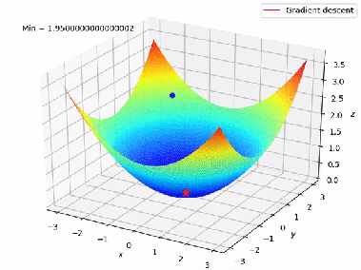
Gradient Descent
An algorithm that attempts to find a local or global minima of a function
Enables model to learn the gradient or direction that the model should take to reduce errors
→ compute the direction of steepest descent and then take a small step downhill and just repeat that over and over again.
Notes:
the algorithm to minimize the function is to compute the direction of steepest descent and then take a small step downhill and just repeat that over and over again until you find the function’s minima.

Slide 10
Gradient Descent for Linear Regression
Recall:
Gradient descent → the process of minimizing a function by following the gradients of the cost function
Linear Regression → a linear system and the coefficients can be calculated analytically using linear algebra

Slide 11
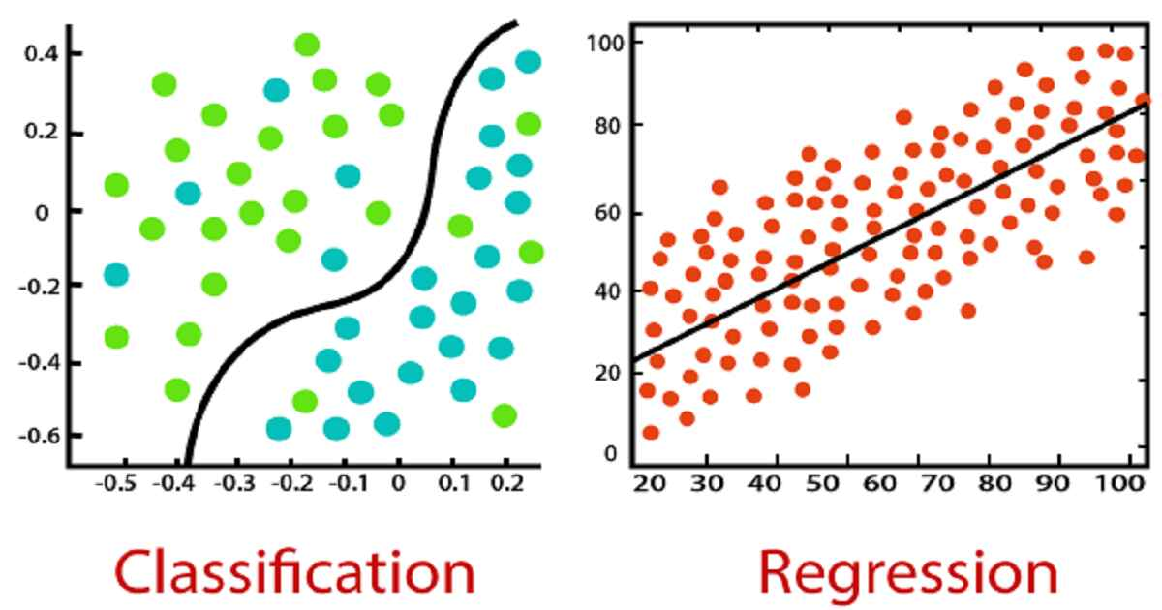
Classification
Notes:
Regression attempts to predict an output value based on an input value
Classification works with a set of output values or “classes”
Predicts a class based on set of input values
In example, we try to separate blue from green

Slide 12
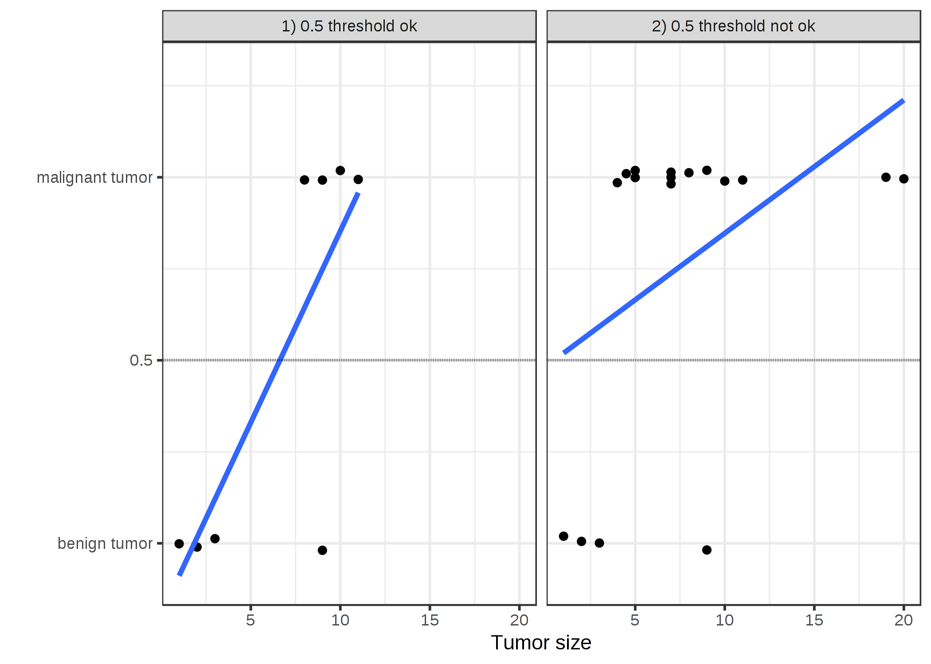
Classification with Linear Regression
Notes:
Positive vs. Negative class
Using linear regression may work
Predict 1 if greater than 0.5, 0 otherwise
Not good enough
What if data was biased towards one outcome?
Our model should be more “decisive”

Slide 13
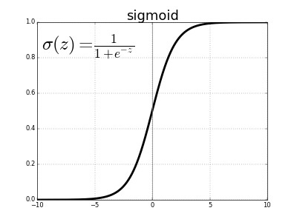
The Sigmoid Function
Notes:
Has anyone seen/used the sigmoid function before?
Logistic Curve, “The S Curve”
Learned in Calculus I
Models growth; Popularity of Trends, Growth of Organisms, Building Construction

Slide 14
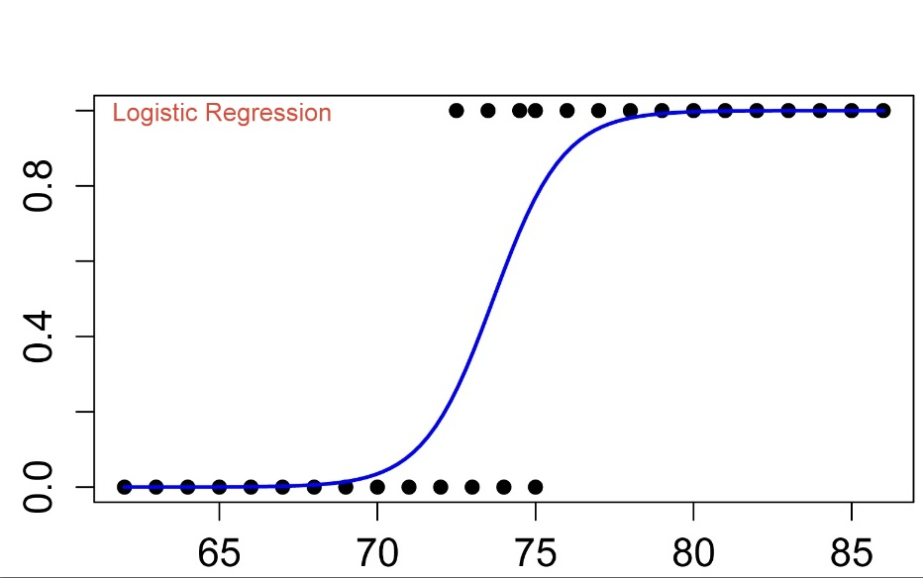
Logistic Regression
Notes:
If sigmoid function > 0.5, predict 1, 0 otherwise
Works much better than linear regression

Slide 15
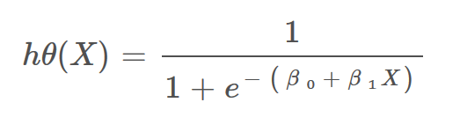
Hypothesis Representation
Notes:
Beta 0 and Beta 1 are the parameters
Looks like linear regression when isolated

Slide 16
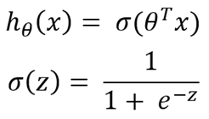
Hypothesis Representation
Notes:
Theta is vector of parameters, x is vector of input values, plugged into sigma

Slide 17
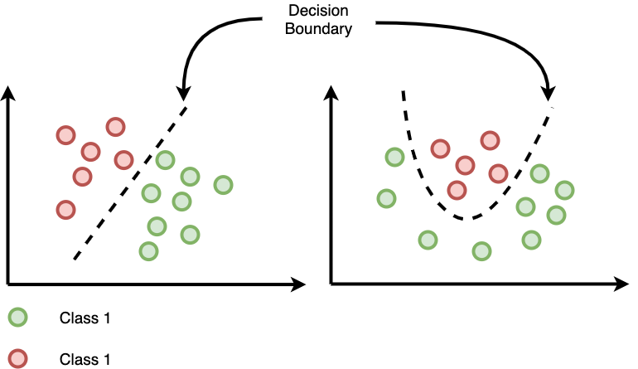
Using Multiple Features
Notes:
We could use multiple inputs
We see groups of data points (“clusters”)
Division line between clusters - “Decision Boundary”
Not necessarily linear; could be quadratic, cubic; could be defined by an equation

Slide 18
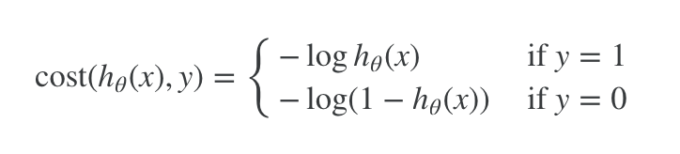
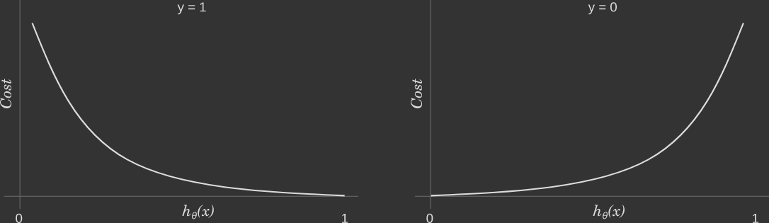
Cost Function
Notes:
Using a different equation means a different cost function
Idea is to punish model for incorrect answers
Closer to the correct answer means less cost

Slide 19
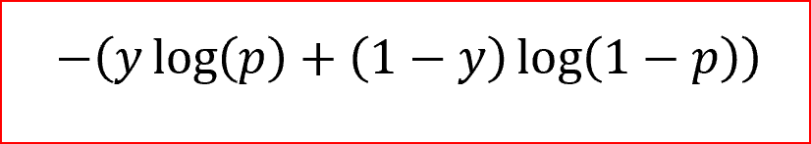
Simplified Cost Function
Notes:
We can simplify the cost function into one expression
If y=0, first term cancels and second term is used

Slide 20
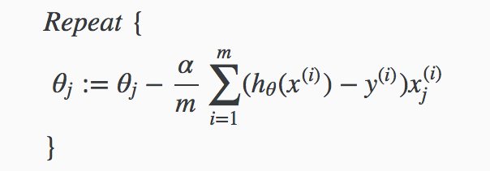
Gradient Descent
Notes:
Looks very similar to linear regression gradient descent
For each parameter, take prediction, subtract from correct answer, multiply by input
Alpha is learning rate, m is number of data entries, j is number of parameters

Slide 21
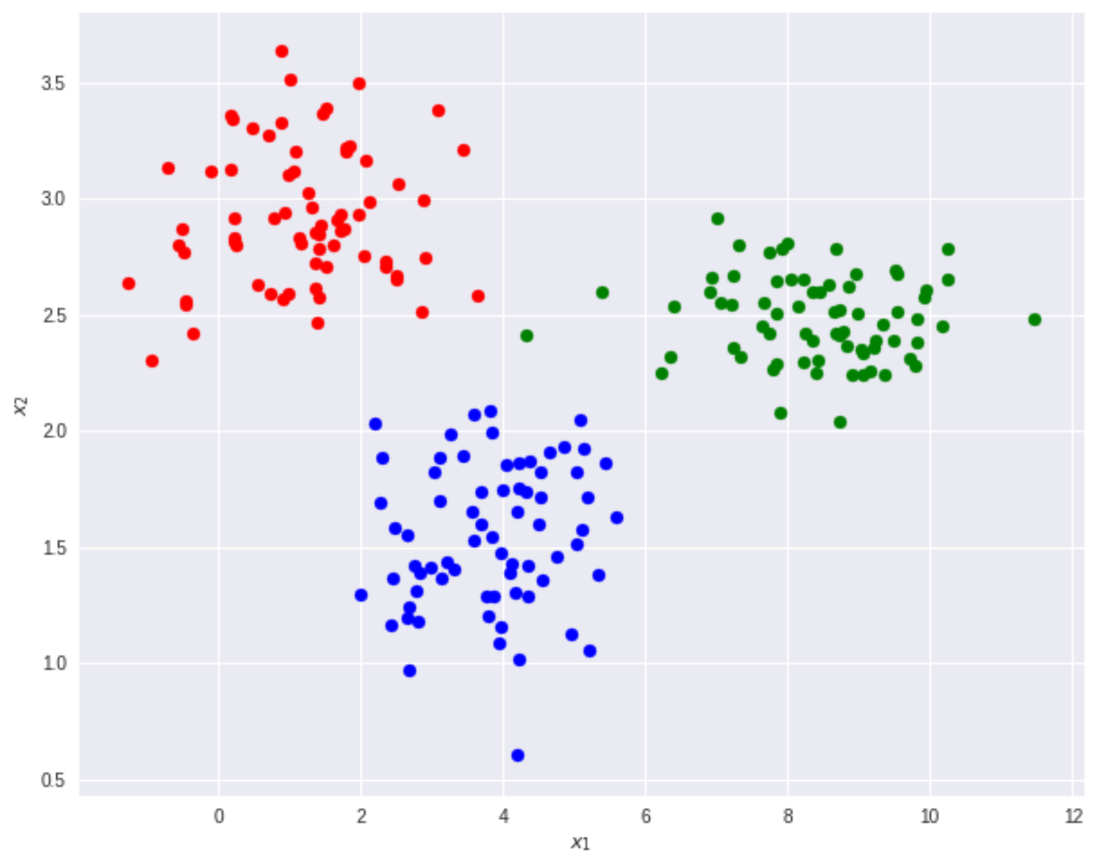
Multiclass Classification: One-vs-all
Notes:
Logistic regression works for multiple classes as well
We would have multiple decision boundaries
One vs. All (One vs. Rest)
First perform logistic regression for everything that is red and isn’t red
“Is red” is positive class, “isn’t red” is negative class
Then, do the same for blue and green
Logistic regression may seem complicated, involves many steps
There are already python packages that do this for us

